Slide 1
Lecture 22

Slide 2
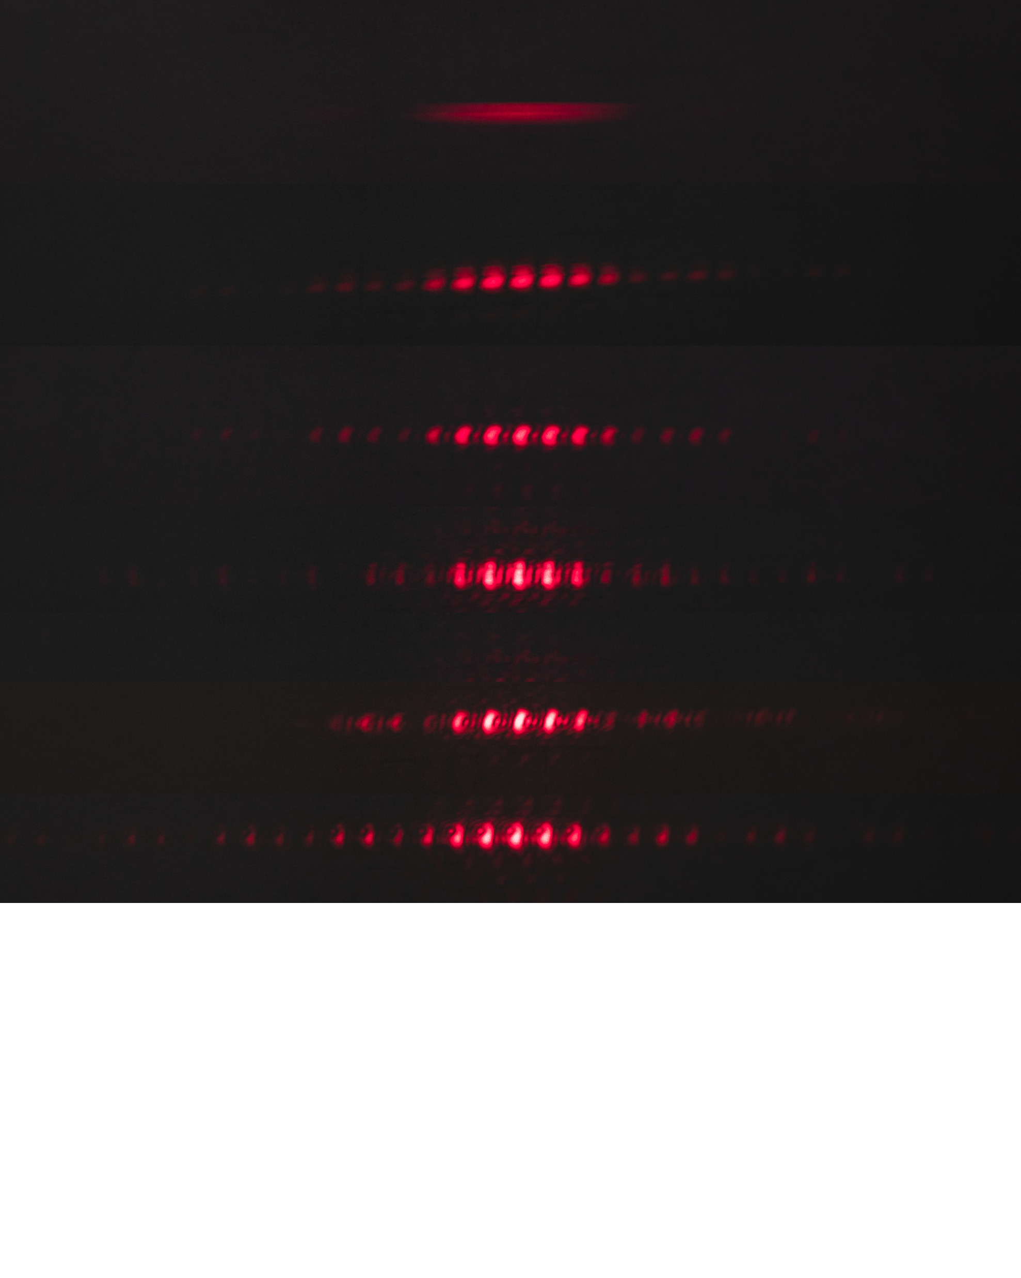
One Slit
Two Slits
Three Slits
Four Slits
Five Slits
Six Slits
Principle Maxima
Secondary Maxima

Slide 3
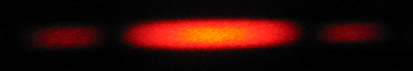
I
Interference fringes:
due to having a single slit
-2π
-π
π
2π
φ/2

Slide 5
Question 223.11.0.1
1
What is the path difference between ray 1 and ray 2?
a)
b)
c)
d)
2
3
a/2
θ
a

Slide 6
Single-Slit Diffraction
a/2
θ
a

Slide 7
Single-Slit Diffraction
5
4
3
2
1
a/2
a
θ

Slide 8
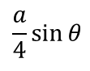
Single-Slit Diffraction
5
4
3
2
1
a/2
a
θ
$$\frac{a}{4}\sin{θ}$$

Slide 9
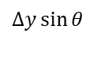
Single-Slit Diffraction
Δy
a
θ
$$∆y\sin{θ}$$

Slide 10
ĵ
P
y
h
θ
-x_{max}
x
x_{max}
î

Slide 13
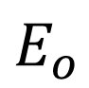
$$E_{o}$$

Slide 14
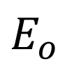
$$E_{o}$$
η
θ

Slide 15
ΔE_{N}
E_{R}
ΔE₁
ΔE₂
ΔE₃
ΔE₄

Slide 17
O
R
R
E_{R}/2
E_{R}
φ

Slide 18
ψ
α
η
γ
φ
α

Slide 22
I
Interference fringes:
due to having a single slit
-2π
-π
π
2π
φ/2

Slide 23
End

